Slide 1
HBSM Monitoring

Slide 2

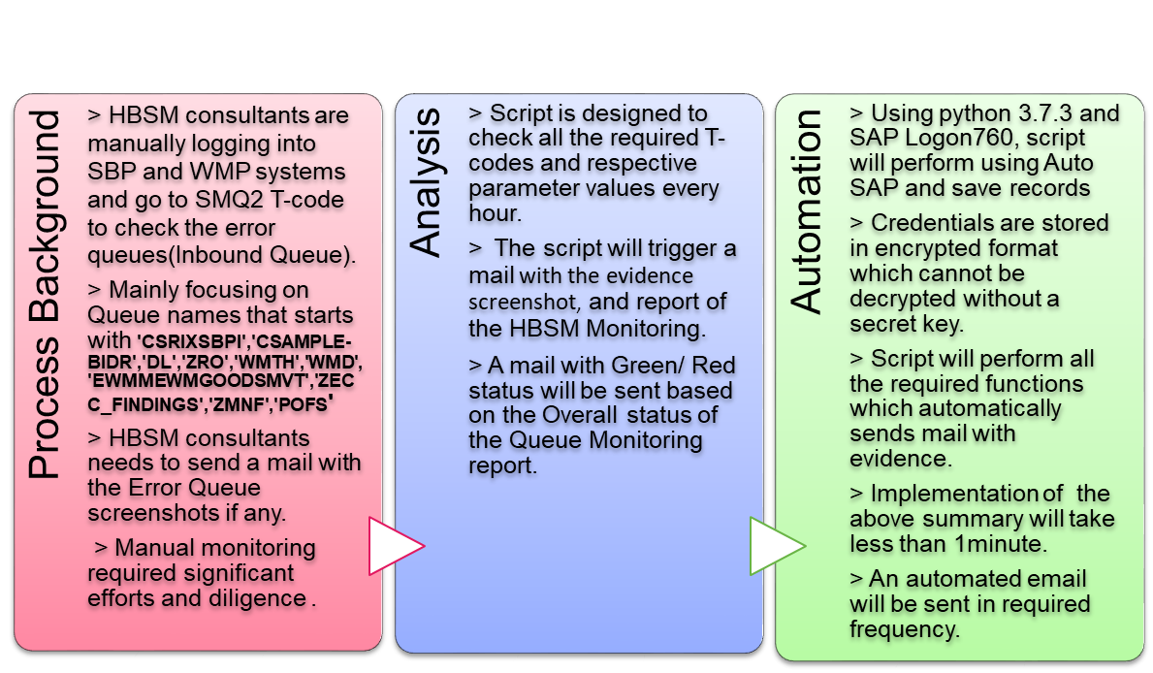
HBSM Monitoring
Business Value
97%
  Reduction in execution time
100%
  Data Accuracy
Zero
  Manual intervention
Evidence
  Better Documentation
30 Hours
  Efforts saved per month-If Monitored Daily Twice

Slide 3

Automation Flow Chart:
Login to SAP System
Enter SMQ2
T-Code
Capture the Data and Store the Evidence
Next System Exist?
No
Generate the Report with respective Values and Status
Send Alert Mail with the Report and Overall Status by Attaching all the Evidence
Logout from System
Yes
Systems – SBP and WMP

Slide 4
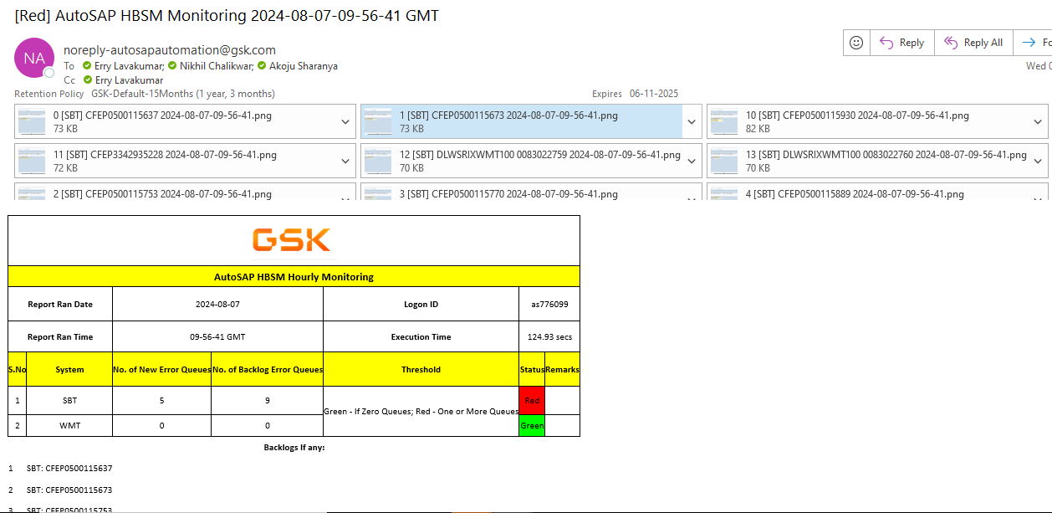
Mail Output:

Slide 5
Thank You

